Slide 1
GOFRAME

Slide 2
Download library
目录/文件名称 | 说明 | 描述
- api | 业务接口 | 接收/解析用户输入参数的入口/接口层。
- dao | 数据访问 | 数据库的访问操作，仅包含最基础的数据库CURD方法
- model | 结构模型 | 数据结构管理模块，管理数据实体对象，以及输入与输出数据结构定义
- service | 逻辑封装 | 业务逻辑封装层，实现特定的业务需求，可供不同的包调用。
app | 业务逻辑层 | 所有的业务逻辑存放目录。
boot | 初始化包 | 用于项目初始化参数设置，往往作为main.go中第一个被import的包。
config | 配置管理 | 所有的配置文件存放目录。
docker | 镜像文件 | Docker镜像相关依赖文件，脚本文件等等。
Dockerfile | 镜像描述 | 云原生时代用于编译生成Docker镜像的描述文件。
document | 项目文档 | Documentation项目文档，如: 设计文档、帮助文档等等。
go.mod | 依赖管理 | 使用Go Module包管理的依赖描述文件。
i18n | I18N国际化 | I18N国际化配置文件目录。
library | 公共库包 | 公共的功能封装包，往往不包含业务需求实现。
main.go | 入口文件 | 程序入口文件。
packed | 打包目录 | 将资源文件打包的Go文件存放在这里，boot包初始化时会自动调用。
public | 静态目录 | 仅有该目录下的文件才能对外提供静态服务访问。
router | 路由注册 | 用于路由统一的注册管理。
template | 模板文件 | MVC模板文件存放的目录。
1.Goframe
2.gf-cli
Gf init xxxx : create new project
Gf run xxxx :

Slide 3
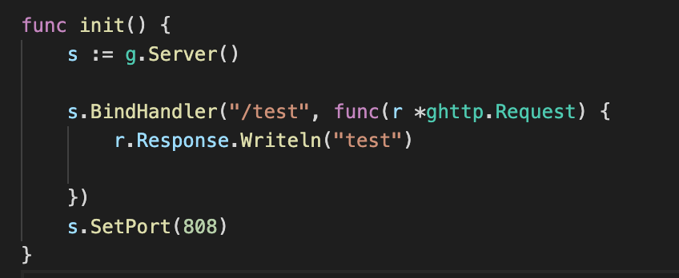
First server

Slide 4
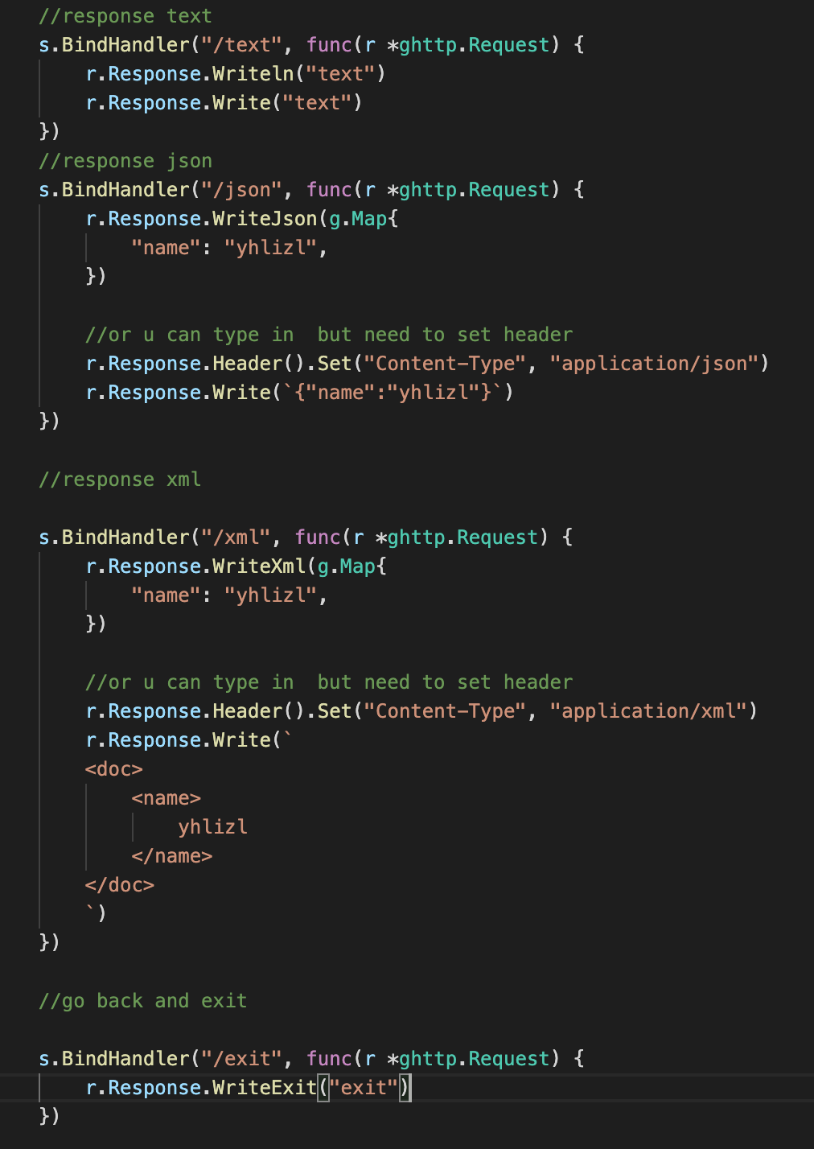
Response
Notes:
s := g.Server()
//response text
s.BindHandler("/text", func(r *ghttp.Request) {
r.Response.Writeln("text")
r.Response.Write("text")
})
//response json
s.BindHandler("/json", func(r *ghttp.Request) {
r.Response.WriteJson(g.Map{
"name": "yhlizl",
})
//or u can type in but need to set header
r.Response.Header().Set("Content-Type", "application/json")
r.Response.Write(`{"name":"yhlizl"}`)
})
//response xml
s.BindHandler("/xml", func(r *ghttp.Request) {
r.Response.WriteXml(g.Map{
"name": "yhlizl",
})
//or u can type in but need to set header
r.Response.Header().Set("Content-Type", "application/xml")
r.Response.Write(`
<doc>
<name>
yhlizl
</name>
</doc>
`)
})
//go back and exit
s.BindHandler("/exit", func(r *ghttp.Request) {
r.Response.WriteExit("exit")
})
s.SetPort(808)

Slide 5
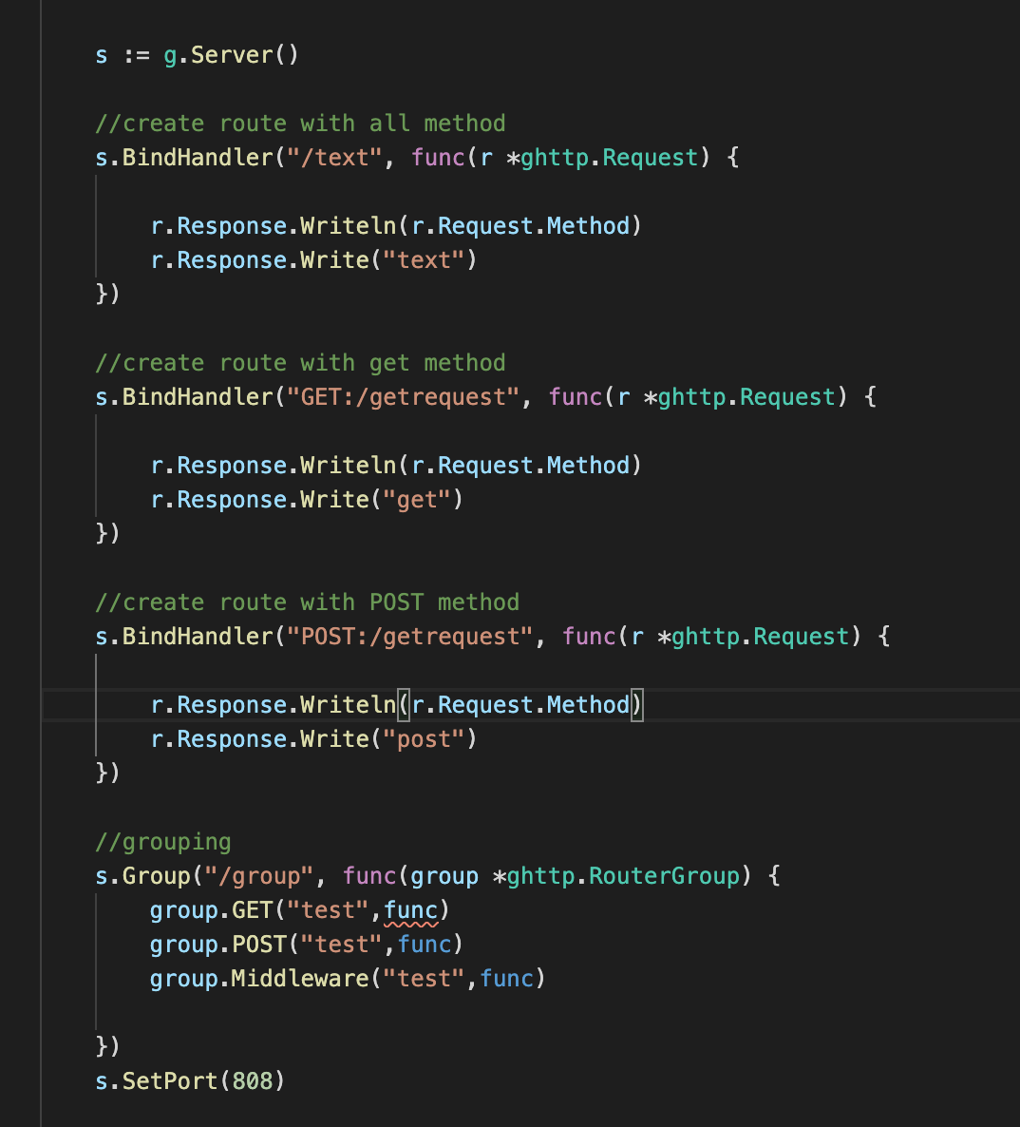
Router
Notes:
package router
import (
"github.com/gogf/gf/frame/g"
"github.com/gogf/gf/net/ghttp"
)
func init() {
// s := g.Server()
// s.Group("/toolstatus", func(group *ghttp.RouterGroup) {
// group.ALL("/", api.Toolstatus)
// })
s := g.Server()
//create route with all method
s.BindHandler("/text", func(r *ghttp.Request) {
r.Response.Writeln(r.Request.Method)
r.Response.Write("text")
})
//create route with get method
s.BindHandler("GET:/getrequest", func(r *ghttp.Request) {
r.Response.Writeln(r.Request.Method)
r.Response.Write("get")
})
//create route with POST method
s.BindHandler("POST:/getrequest", func(r *ghttp.Request) {
r.Response.Writeln(r.Request.Method)
r.Response.Write("post")
})
//grouping
s.Group("/group", func(group *ghttp.RouterGroup) {
group.GET("test",func)
group.POST("test",func)
group.Middleware("test",func)
})
s.SetPort(808)
}

Slide 6
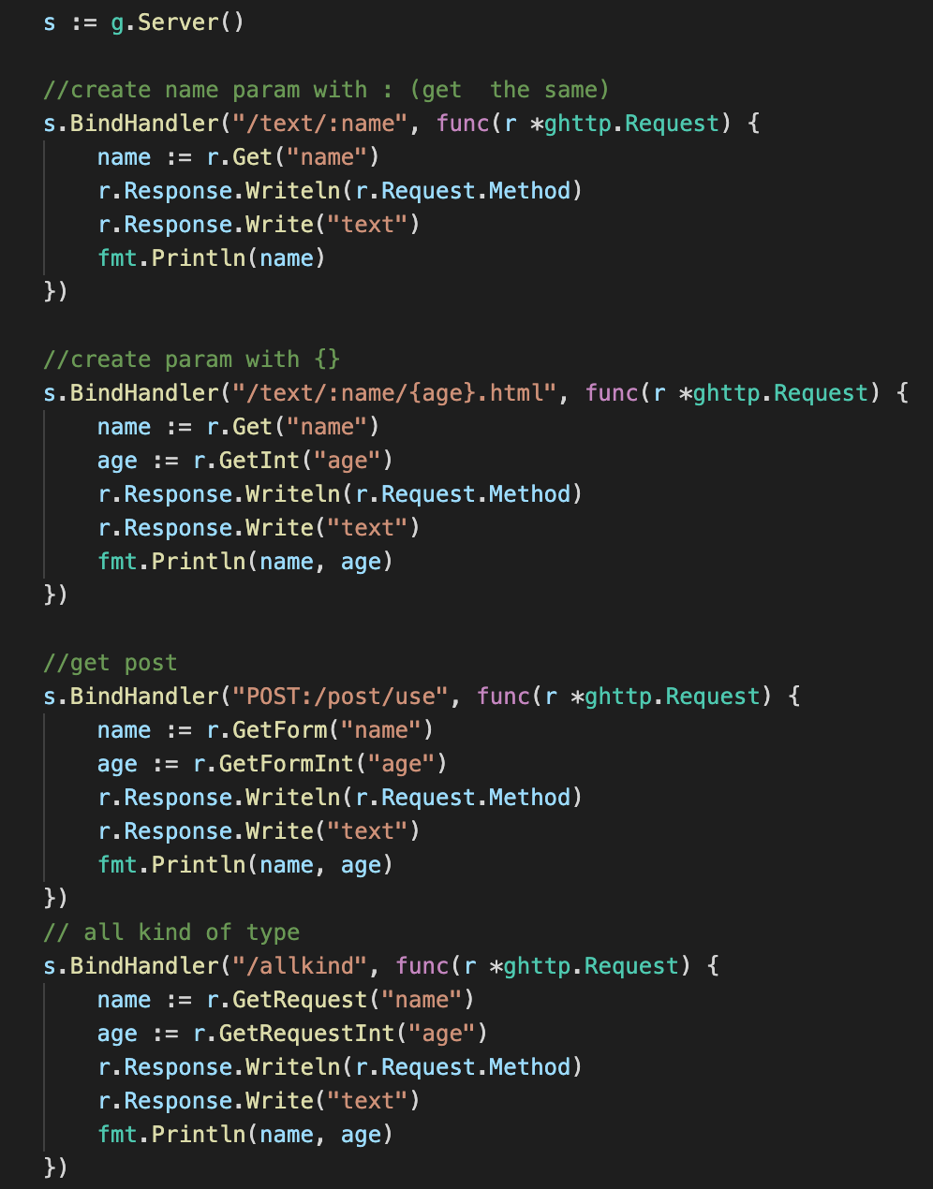
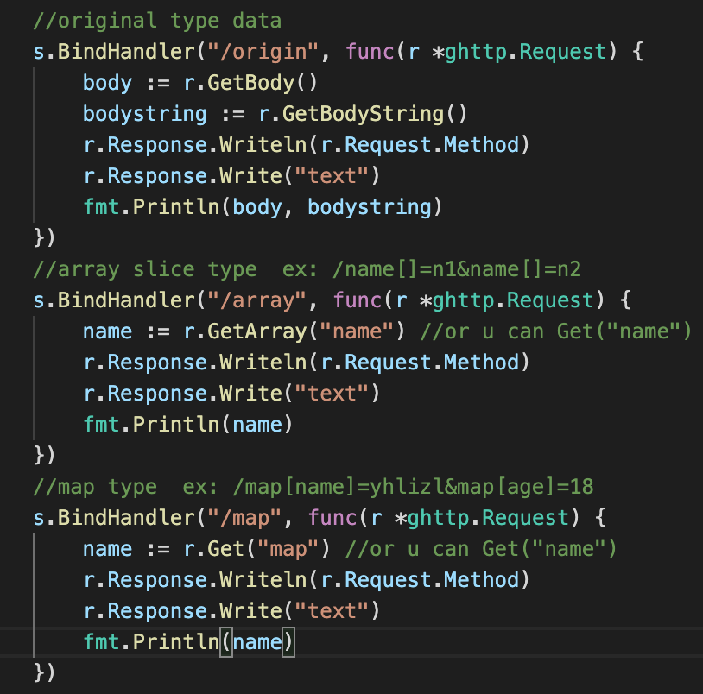
Parameter
Notes:
s := g.Server()
//create name param with : (get the same)
s.BindHandler("/text/:name", func(r *ghttp.Request) {
name := r.Get("name")
r.Response.Writeln(r.Request.Method)
r.Response.Write("text")
fmt.Println(name)
})
//create param with {}
s.BindHandler("/text/:name/{age}.html", func(r *ghttp.Request) {
name := r.Get("name")
age := r.GetInt("age")
r.Response.Writeln(r.Request.Method)
r.Response.Write("text")
fmt.Println(name, age)
})
//get post
s.BindHandler("POST:/post/use", func(r *ghttp.Request) {
name := r.GetForm("name")
age := r.GetFormInt("age")
r.Response.Writeln(r.Request.Method)
r.Response.Write("text")
fmt.Println(name, age)
})
// all kind of type
s.BindHandler("/allkind", func(r *ghttp.Request) {
name := r.GetRequest("name")
age := r.GetRequestInt("age")
r.Response.Writeln(r.Request.Method)
r.Response.Write("text")
fmt.Println(name, age)
})
//original type data
s.BindHandler("/origin", func(r *ghttp.Request) {
body := r.GetBody()
bodystring := r.GetBodyString()
r.Response.Writeln(r.Request.Method)
r.Response.Write("text")
fmt.Println(body, bodystring)
})
//array slice type ex: /name[]=n1&name[]=n2
s.BindHandler("/array", func(r *ghttp.Request) {
name := r.GetArray("name") //or u can Get("name")
r.Response.Writeln(r.Request.Method)
r.Response.Write("text")
fmt.Println(name)
})
//map type ex: /map[name]=yhlizl&map[age]=18
s.BindHandler("/map", func(r *ghttp.Request) {
name := r.Get("map") //or u can Get("name")
r.Response.Writeln(r.Request.Method)
r.Response.Write("text")
fmt.Println(name)
})
s.SetPort(808)

Slide 7
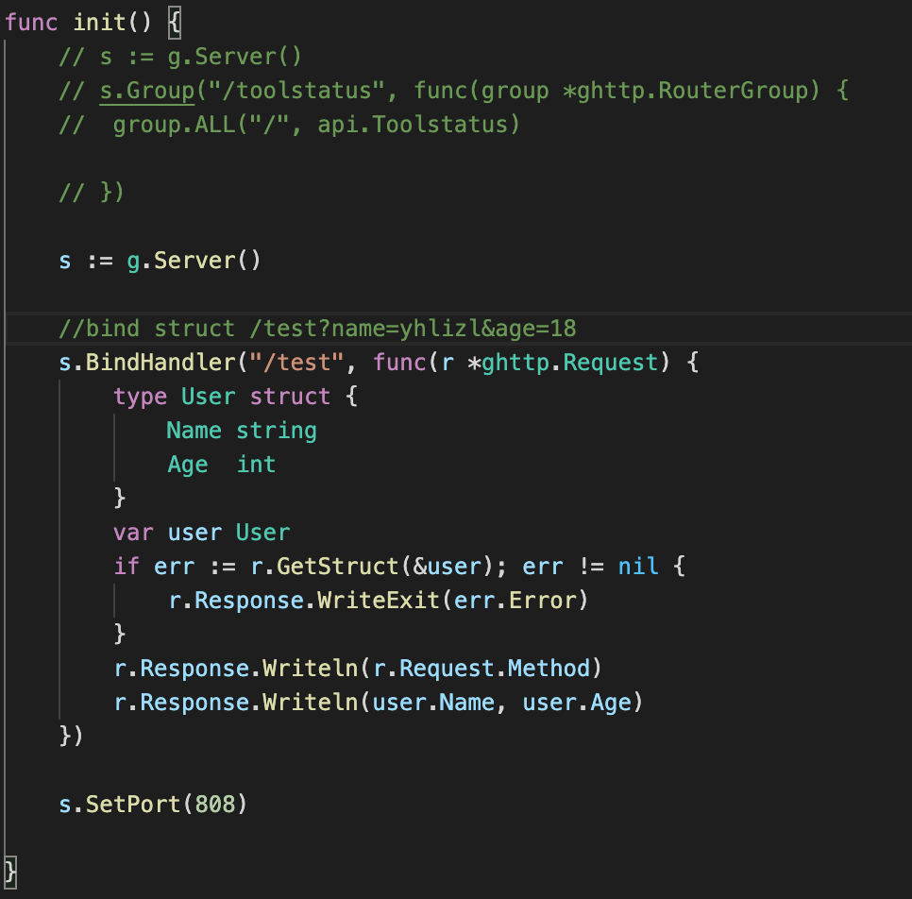
Params bind to struct
Notes:
package router
import (
"github.com/gogf/gf/frame/g"
"github.com/gogf/gf/net/ghttp"
)
func init() {
// s := g.Server()
// s.Group("/toolstatus", func(group *ghttp.RouterGroup) {
// group.ALL("/", api.Toolstatus)
// })
s := g.Server()
//bind struct /test?name=yhlizl&age=18
s.BindHandler("/test", func(r *ghttp.Request) {
type User struct {
Name string
Age int
}
var user User
if err := r.GetStruct(&user); err != nil {
r.Response.WriteExit(err.Error)
}
r.Response.Writeln(r.Request.Method)
r.Response.Writeln(user.Name, user.Age)
})
s.SetPort(808)
}

Slide 8
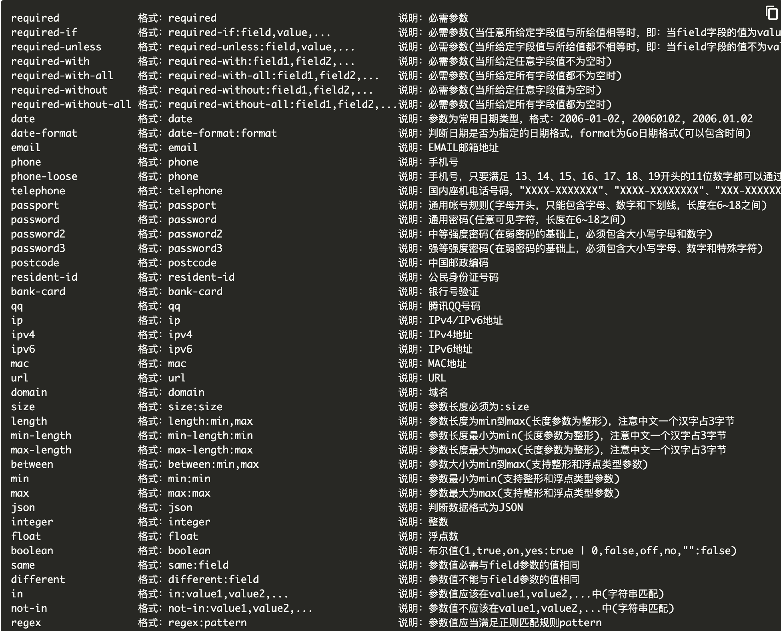
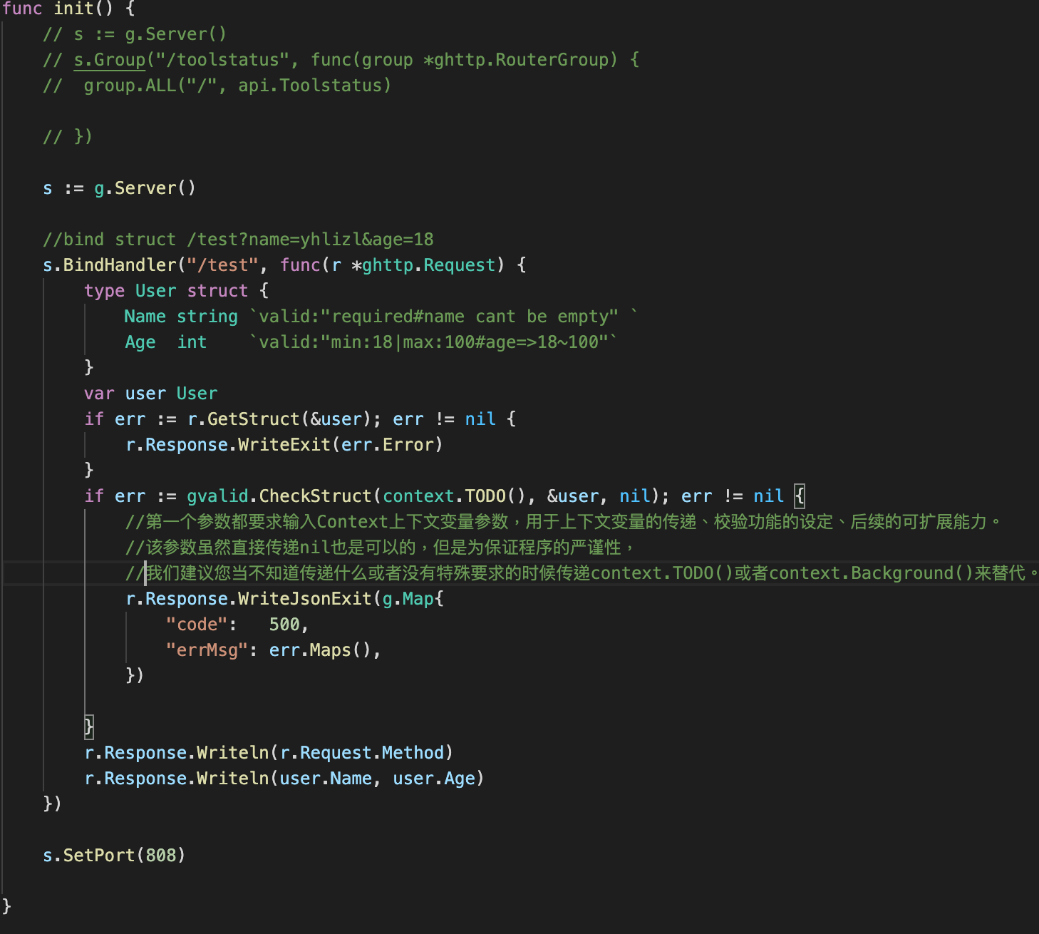
Params precheck
https://goframe.org/pages/viewpage.action?pageId=1114678&src=contextnavpagetreemode
Notes:
package router
import (
"context"
"github.com/gogf/gf/frame/g"
"github.com/gogf/gf/net/ghttp"
"github.com/gogf/gf/util/gvalid"
)
func init() {
// s := g.Server()
// s.Group("/toolstatus", func(group *ghttp.RouterGroup) {
// group.ALL("/", api.Toolstatus)
// })
s := g.Server()
//bind struct /test?name=yhlizl&age=18
s.BindHandler("/test", func(r *ghttp.Request) {
type User struct {
Name string `valid:"required#name cant be empty" `
Age int `valid:"min:18|max:100#age=>18~100"`
}
var user User
if err := r.GetStruct(&user); err != nil {
r.Response.WriteExit(err.Error)
}
if err := gvalid.CheckStruct(context.TODO(), &user, nil); err != nil {
//第一个参数都要求输入Context上下文变量参数，用于上下文变量的传递、校验功能的设定、后续的可扩展能力。
//该参数虽然直接传递nil也是可以的，但是为保证程序的严谨性，
//我们建议您当不知道传递什么或者没有特殊要求的时候传递context.TODO()或者context.Background()来替代。
r.Response.WriteJsonExit(g.Map{
"code": 500,
"errMsg": err.Maps(),
})
}
r.Response.Writeln(r.Request.Method)
r.Response.Writeln(user.Name, user.Age)
})
s.SetPort(808)
}

Slide 9
Upload files
Notes:
package router
import (
"github.com/gogf/gf/frame/g"
"github.com/gogf/gf/net/ghttp"
)
func init() {
// s := g.Server()
// s.Group("/toolstatus", func(group *ghttp.RouterGroup) {
// group.ALL("/", api.Toolstatus)
// })
s := g.Server()
//upload 1 file
s.BindHandler("/upload", func(r *ghttp.Request) {
if r.Method == "GET" {
r.Response.WriteTpl("index.html")
/**
<form action= "/upload" method="post" enctype="multipart/form-data">
<input type="file" name ="file">
<input type="subit">
</form>
**/
} else if r.Method == "POST" {
f := r.GetUploadFile("file") //only 1 file
if fname, err := f.Save("./upload", true); err != nil {
//true => rename
r.Response.Writeln("fail")
} else {
r.Response.Writeln("success", fname)
}
}
})
//upload 1 file
s.BindHandler("/uploads", func(r *ghttp.Request) {
if r.Method == "GET" {
r.Response.WriteTpl("index.html")
/**
<form action= "/upload" method="post" enctype="multipart/form-data">
<input type="file" name ="file">
<input type="file" name ="file">
<input type="subit">
</form>
**/
} else if r.Method == "POST" {
f := r.GetUploadFiles("file")
if fname, err := f.Save("./upload", false); err != nil {
r.Response.Writeln("fail")
} else {
r.Response.Writeln("success", fname)
}
}
})
s.SetPort(808)
}

Slide 10
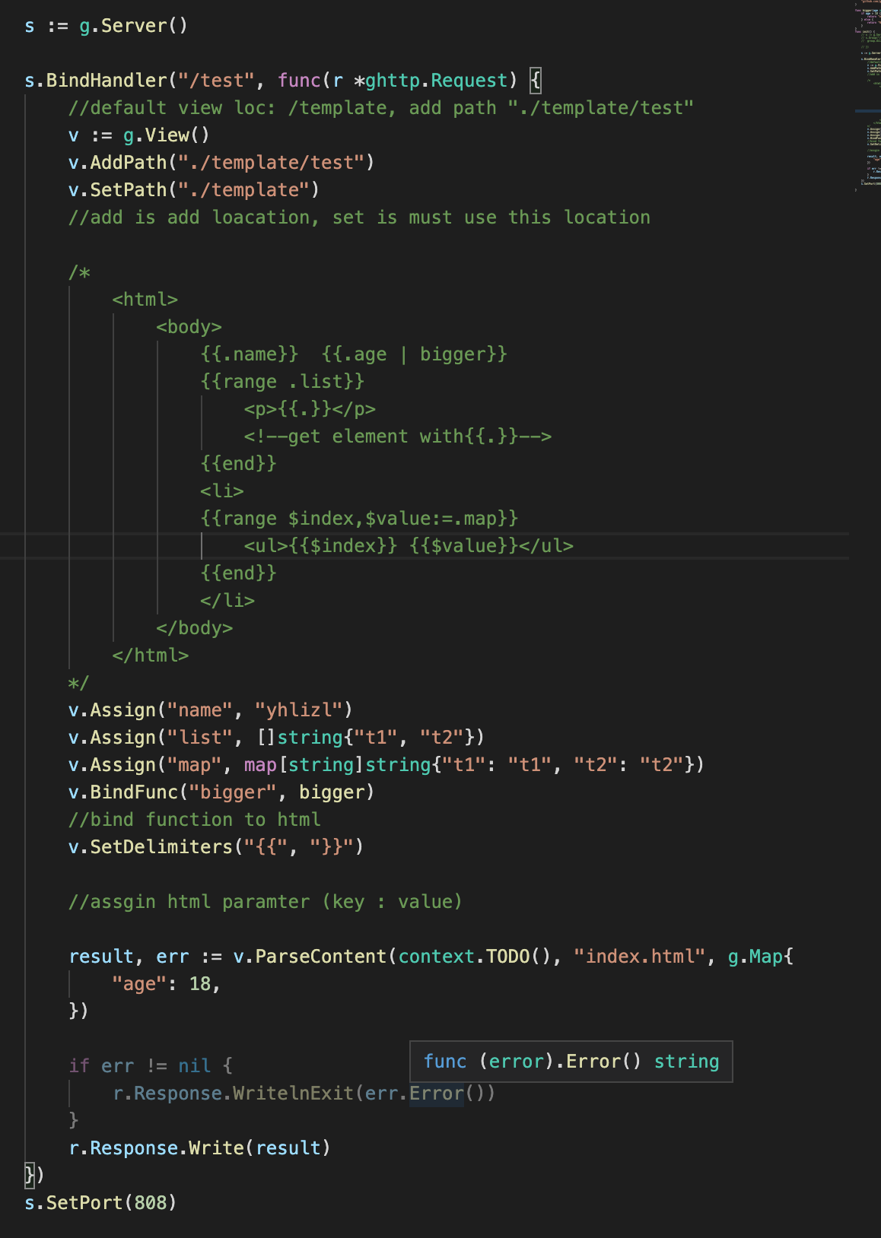
Template Engine
Notes:
package router
import (
"context"
"github.com/gogf/gf/frame/g"
"github.com/gogf/gf/net/ghttp"
)
func bigger(age int) string {
if age > 18 {
return "ok"
} else {
return "NG"
}
}
func init() {
// s := g.Server()
// s.Group("/toolstatus", func(group *ghttp.RouterGroup) {
// group.ALL("/", api.Toolstatus)
// })
s := g.Server()
s.BindHandler("/test", func(r *ghttp.Request) {
//default view loc: /template, add path "./template/test"
v := g.View()
v.AddPath("./template/test")
v.SetPath("./template")
//add is add loacation, set is must use this location
/*
<html>
<body>
{{.name}} {{.age | bigger}}
{{range .list}}
<p>{{.}}</p>
<!--get element with{{.}}-->
{{end}}
<li>
{{range $index,$value:=.map}}
<ul>{{$index}} {{$value}}</ul>
{{end}}
</li>
</body>
</html>
*/
v.Assign("name", "yhlizl")
v.Assign("list", []string{"t1", "t2"})
v.Assign("map", map[string]string{"t1": "t1", "t2": "t2"})
v.BindFunc("bigger", bigger)
//bind function to html
v.SetDelimiters("{{", "}}")
//assgin html paramter (key : value)
result, err := v.Parse(context.TODO(), "index.html", g.Map{
"age": 18,
})
if err != nil {
r.Response.WritelnExit(err.Error())
}
r.Response.Write(result)
})
s.SetPort(808)
}

Slide 11
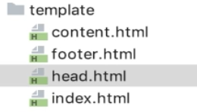
Template define
{{define “head”}}
<head>
</head>
{{end}}
<html>
<body>
{{template “head}}
{{include “content”}}
<!-- public html -->
{{template “footer”}}
</body>
<html>

Slide 12
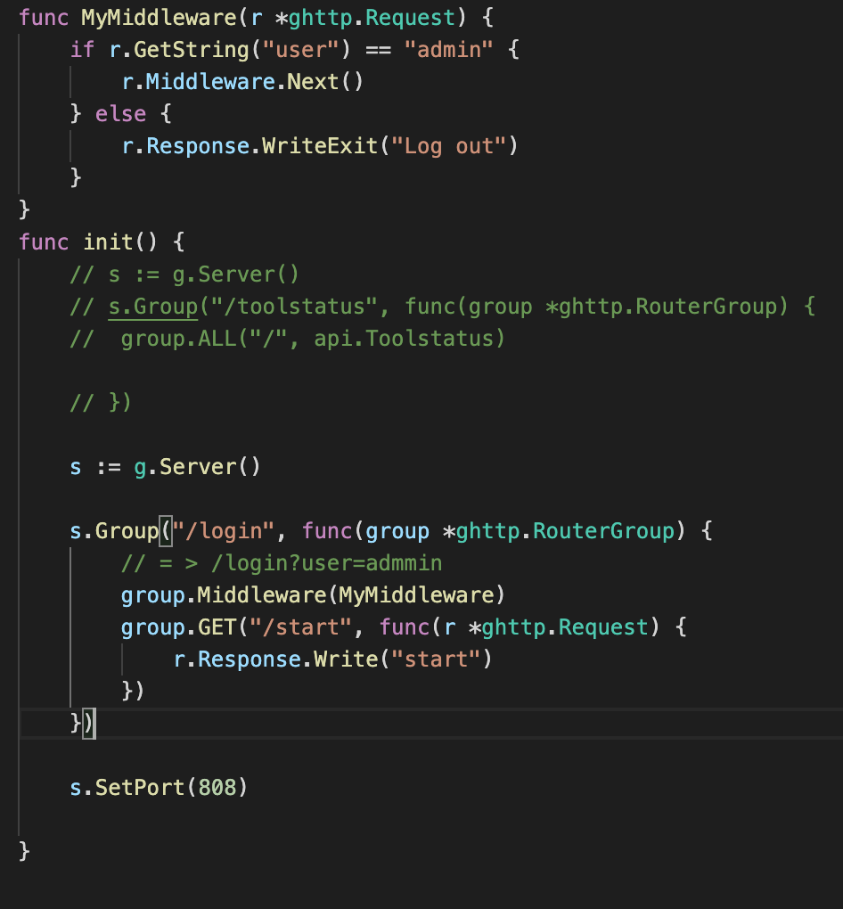
Middleware
Notes:
package router
import (
"github.com/gogf/gf/frame/g"
"github.com/gogf/gf/net/ghttp"
)
func MyMiddleware(r *ghttp.Request) {
if r.GetString("user") == "admin" {
r.Middleware.Next()
} else {
r.Response.WriteExit("Log out")
}
}
func init() {
// s := g.Server()
// s.Group("/toolstatus", func(group *ghttp.RouterGroup) {
// group.ALL("/", api.Toolstatus)
// })
s := g.Server()
s.Group("/login", func(group *ghttp.RouterGroup) {
// = > /login?user=admmin
group.Middleware(MyMiddleware)
group.GET("/start", func(r *ghttp.Request) {
r.Response.Write("start")
})
})
s.SetPort(808)
}

Slide 13
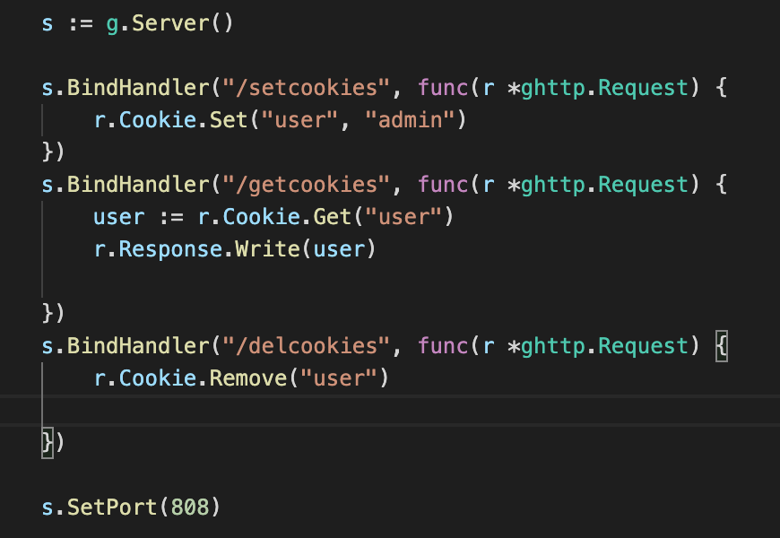
Cookies
Notes:
package router
import (
"github.com/gogf/gf/frame/g"
"github.com/gogf/gf/net/ghttp"
)
func init() {
// s := g.Server()
// s.Group("/toolstatus", func(group *ghttp.RouterGroup) {
// group.ALL("/", api.Toolstatus)
// })
s := g.Server()
s.BindHandler("/setcookies", func(r *ghttp.Request) {
r.Cookie.Set("user", "admin")
})
s.BindHandler("/getcookies", func(r *ghttp.Request) {
user := r.Cookie.Get("user")
r.Response.Write(user)
})
s.BindHandler("/delcookies", func(r *ghttp.Request) {
r.Cookie.Remove("user")
})
s.SetPort(808)
}

Slide 14
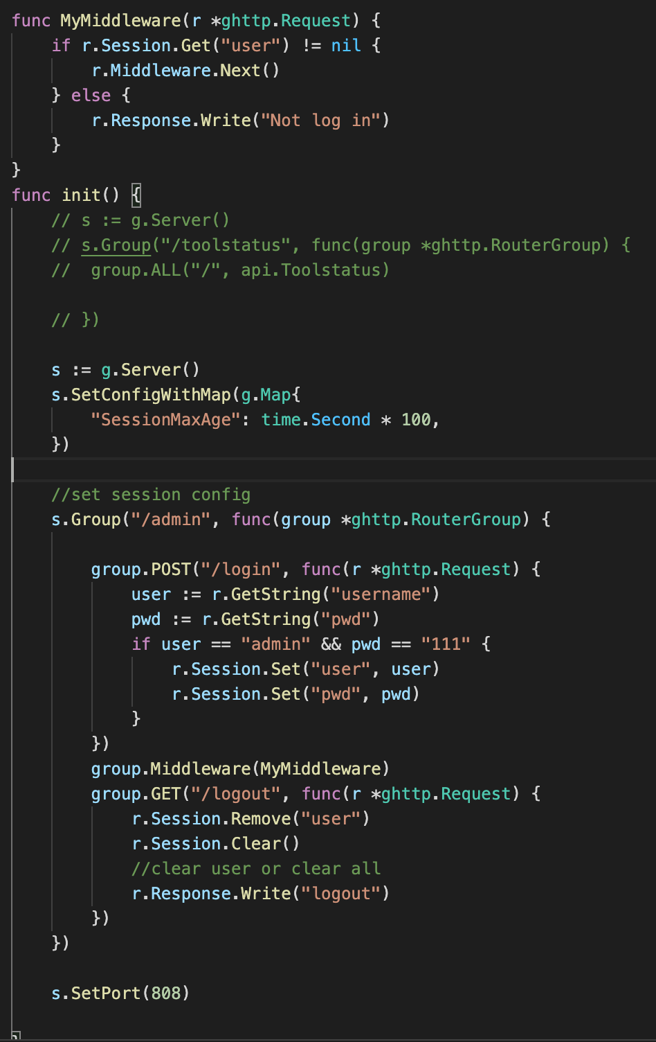
Session to login
//default 是內存與文件
"SessionPath": "/tmp/MySessionStoragePath",
//內存 高校但關掉就沒了 s.SetConfigWithMap(g.Map{
"SessionMaxAge": time.Minute,
"SessionStorage": gsession.NewStorageMemory(),
})
//redis
s.SetConfigWithMap(g.Map{
"SessionMaxAge": time.Minute,
"SessionStorage": gsession.NewStorageRedis(g.Redis()),
})
Notes:
package router
import (
"time"
"github.com/gogf/gf/frame/g"
"github.com/gogf/gf/net/ghttp"
)
func MyMiddleware(r *ghttp.Request) {
if r.Session.Get("user") != nil {
r.Middleware.Next()
} else {
r.Response.Write("Not log in")
}
}
func init() {
// s := g.Server()
// s.Group("/toolstatus", func(group *ghttp.RouterGroup) {
// group.ALL("/", api.Toolstatus)
// })
s := g.Server()
s.SetConfigWithMap(g.Map{
"SessionMaxAge": time.Second * 100,
})
//set session config
s.Group("/admin", func(group *ghttp.RouterGroup) {
group.POST("/login", func(r *ghttp.Request) {
user := r.GetString("username")
pwd := r.GetString("pwd")
if user == "admin" && pwd == "111" {
r.Session.Set("user", user)
r.Session.Set("pwd", pwd)
}
})
group.Middleware(MyMiddleware)
group.GET("/logout", func(r *ghttp.Request) {
r.Session.Remove("user")
r.Session.Clear()
//clear user or clear all
r.Response.Write("logout")
})
})
s.SetPort(808)
}

Slide 15
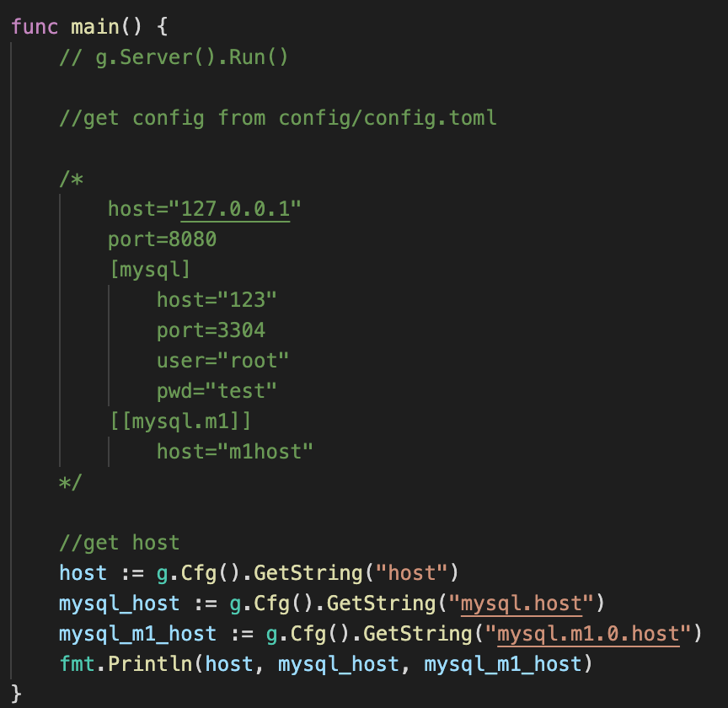
Config
Notes:
package main
import (
"fmt"
_ "sreTool/boot"
_ "sreTool/router"
"github.com/gogf/gf/frame/g"
)
func main() {
// g.Server().Run()
//get config from config/config.toml
/*
host="127.0.0.1"
port=8080
[mysql]
host="123"
port=3304
user="root"
pwd="test"
[[mysql.m1]]
host="m1host"
*/
//get host
host := g.Cfg().GetString("host")
mysql_host := g.Cfg().GetString("mysql.host")
mysql_m1_host := g.Cfg().GetString("mysql.m1.0.host")
fmt.Println(host, mysql_host, mysql_m1_host)
}

Slide 16
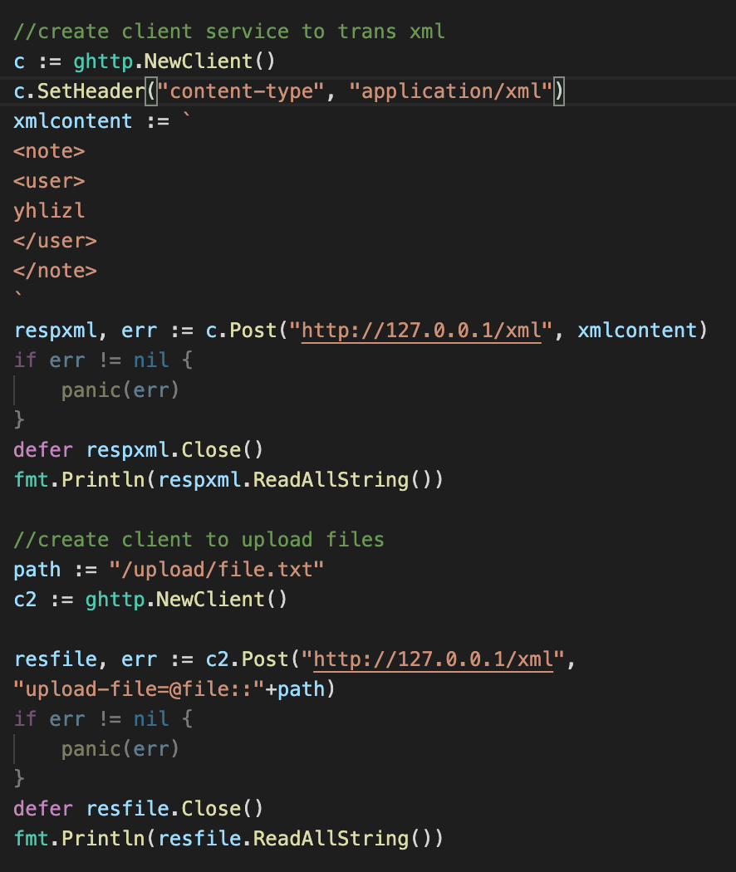
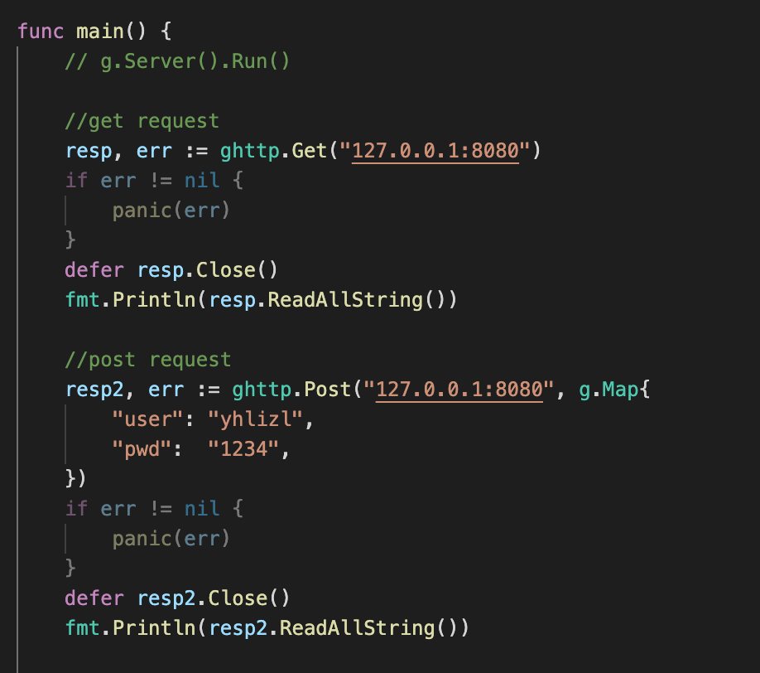
Client http request
Notes:
package main
import (
"fmt"
_ "sreTool/boot"
_ "sreTool/router"
"github.com/gogf/gf/frame/g"
"github.com/gogf/gf/net/ghttp"
)
func main() {
// g.Server().Run()
//get request
resp, err := ghttp.Get("127.0.0.1:8080")
if err != nil {
panic(err)
}
defer resp.Close()
fmt.Println(resp.ReadAllString())
//post request
resp2, err := ghttp.Post("127.0.0.1:8080", g.Map{
"user": "yhlizl",
"pwd": "1234",
})
if err != nil {
panic(err)
}
defer resp2.Close()
fmt.Println(resp2.ReadAllString())
//create client service to trans xml
c := ghttp.NewClient()
c.SetHeader("content-type", "application/xml")
xmlcontent := `
<note>
<user>
yhlizl
</user>
</note>
`
respxml, err := c.Post("http://127.0.0.1/xml", xmlcontent)
if err != nil {
panic(err)
}
defer respxml.Close()
fmt.Println(respxml.ReadAllString())
//create client to upload files
path := "/upload/file.txt"
c2 := ghttp.NewClient()
resfile, err := c2.Post("http://127.0.0.1/xml",
"upload-file=@file::"+path)
if err != nil {
panic(err)
}
defer resfile.Close()
fmt.Println(resfile.ReadAllString())
}

